Slide 1

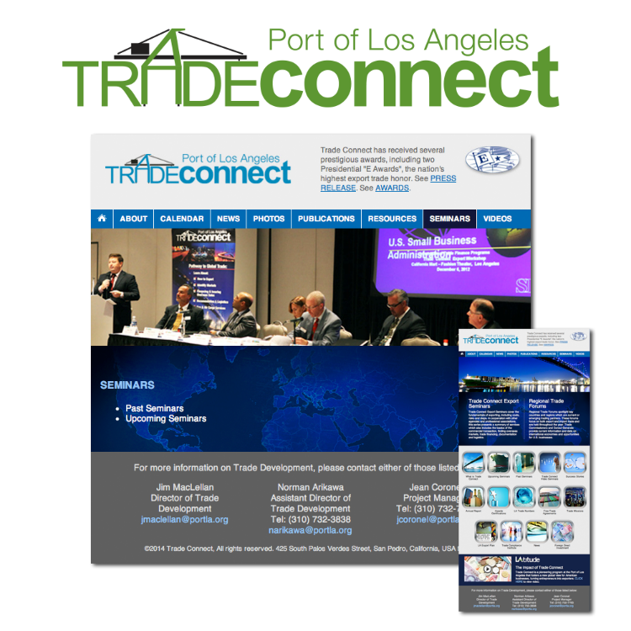
Port of
Los Angeles
Trade Connect Website
Websites

